Slide 1
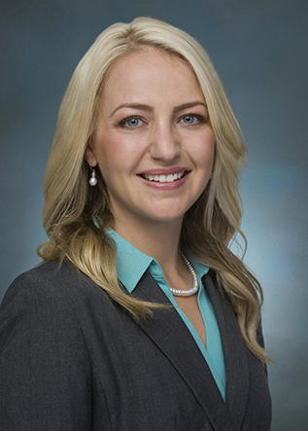
Real-Life Examples of Common Copyright Missteps
Kyle N. Siegal
Associate, Intellectual Property Group, Phoenix
KSiegal@LRRC.com
Rachel A. Nicholas
Associate, Intellectual Property Group, Phoenix
RNicholas@LRRC.com

Slide 2
Today’s Themes
Basic (but dangerous) assumptions
Fair use faux pas
Licensing/contracting mistakes
Misunderstanding copyright exemptions

Slide 3
Topics Considered
Misunderstanding the Face-to-Face Teaching Exemption
Assuming foreign works are not protected in the U.S.
Assuming a work is in the public domain because the Internet says so or because the work lacks a copyright notice
Assuming that purchasing a license is the end of the story
Assuming that educational use is the same as fair use
Assuming an institution owns the copyrights in works created by its employees
Assuming that only the content host need consider fair use when submitting a DMCA take-down request
Misunderstanding the Non-Profit Exemption
Assuming fair use when sharing via social media
Assuming that internal-only use within an institution is noninfringing

Slide 4
Misunderstanding the Face-to-Face Teaching Exemption

Slide 5
The Face-to-Face Teaching Exemption
“[T]he following are not infringements of copyright:
. . . .
(1) performance or display of a work by instructors or pupils in the course of face-to-face teaching activities of a nonprofit educational institution, in a classroom or similar place devoted to instruction,
unless, in the case of a motion picture or other audiovisual work, the performance, or the display of individual images, is given by means of a copy that was not lawfully made under this title, and that the person responsible for the performance knew or had reason to believe was not lawfully made;
17 U.S.C § 110(1)
Notice the conditions?

Slide 6
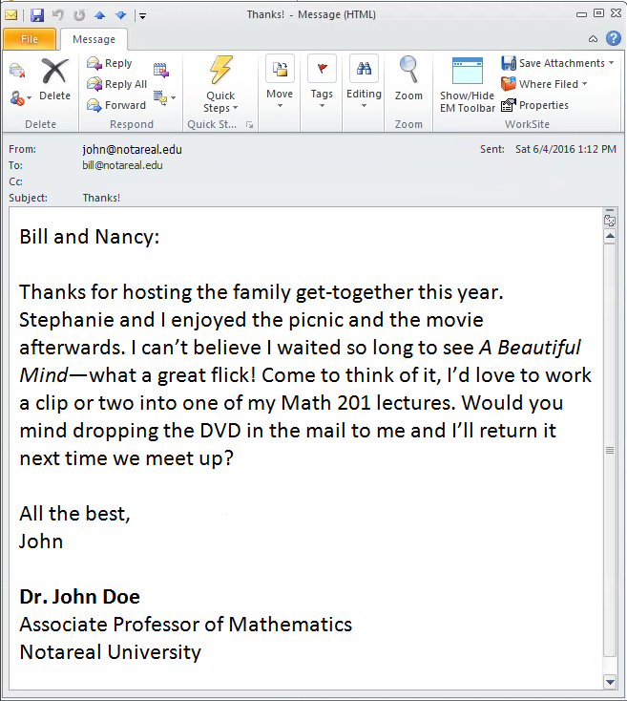
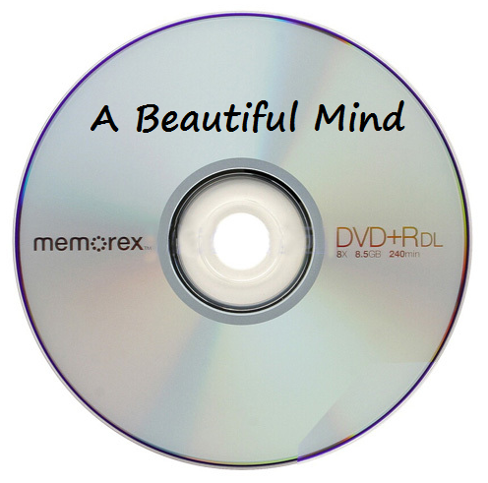
The Face-to-Face Teaching Exemption

Slide 7
Face-to-Face Teaching Exemption
TAKE-HOME
When showing video clips or screenshots from video clips, don’t rely on the face-to-face teaching exemption if you have reason to believe the copy you’re using was made without the copyright owner’s permission.

Slide 8
Assuming foreign works are not protected in the U.S.

Slide 9
Using Foreign Works
Itar-Tass Russian News Agency v. Russian Kurier, Inc., 153 F.3d 82 (2d Cir. 1998)
Publishers of foreign newspapers brought copyright infringement action against American newspaper and its publisher, alleging copying of plaintiffs' Russian news articles.
As Russia is a member of Berne Convention and the U.C.C., infringement issues determined under United States copyright law
Article 5 of the Berne Convention:
“Authors shall enjoy, in respect of works for which they are protected under this Convention, in countries of the Union other than the country of origin, the rights which their respective laws do now or may hereafter grant to their nationals, as well as the rights specially granted by this Convention.”

Slide 10
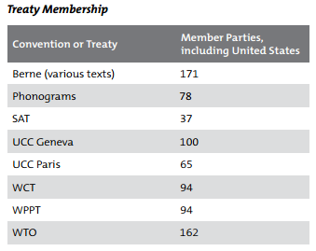
Using Foreign Works
How many contracting parties to the Berne Convention?
171 (http://www.wipo.int/treaties/en/ShowResults.jsp?treaty_id=15)
How many signatories to the Universal Copyright Convention?
100 (http://www.wipo.int/wipolex/en/other_treaties/parties.jsp?treaty_id=208&group_id=22)

Slide 11
Using Foreign Works
TAKE-AWAY
Treat works created outside the U.S. the same way you treat works created inside the U.S.—get permission if at all possible.

Slide 12
Assuming a work is in the “public domain” because the Internet says so or because the work lacks a © notice

Slide 13
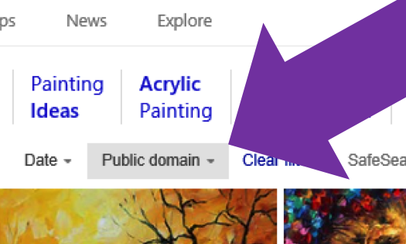
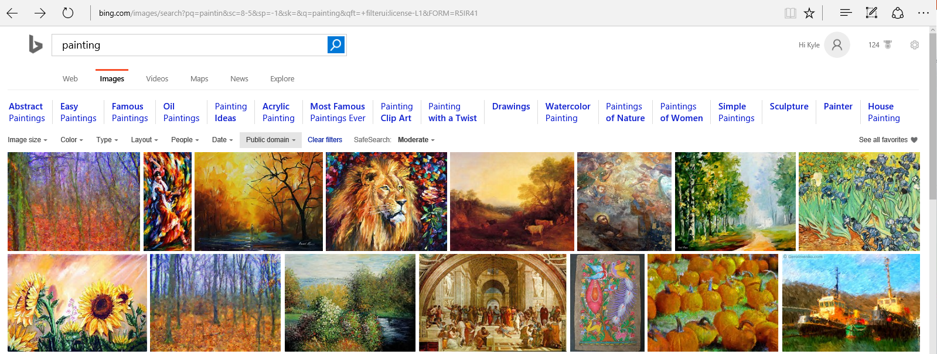
Assuming Public Domain Status

Slide 14
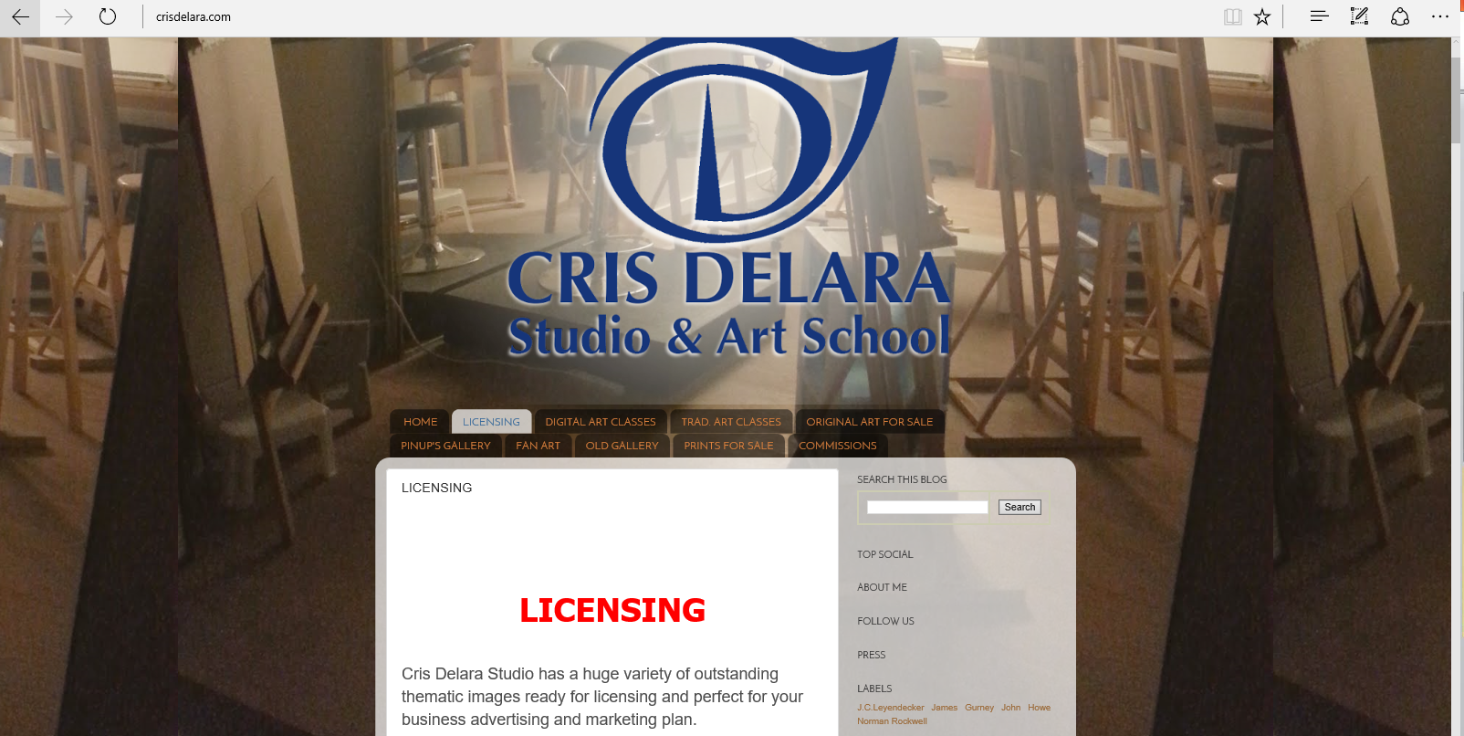
Assuming Public Domain Status

Slide 15
Assuming Public Domain Status

Slide 16
Assuming Public Domain Status
TAKE-AWAY
Don’t rely on representations made by Bing, Wikipedia, or other Internet sources when it comes to determining whether a use may be in the public domain.

Slide 17
Assuming Public Domain Status
A small business’s Nebraska photo woes
A company writes blog posts for its clients
One of its writers published a blog post to a client’s site – it was about finding great deals in Omaha, Nebraska
The post included a picture found online, one with no copyright notice, and the post linked back to the photo source and cited the photographer’s name
Cost? $3k
A web copywriter’s expensive assumption
This company does pretty much the same thing
Also maintains an active stock photo account for its blog with access to an array of suitable photos
One of its copywriters grabbed a photo from the web – one with no copyright notice – a beach shot with some greenery in the foreground
Cost? $4k

Slide 18
Assuming Public Domain Status
TAKE-AWAY
Copyright notices are OPTIONAL. Always assume, as a baseline, that a work is protected. Always get permission if possible (asking forgiveness can be expensive)! Relying on exemptions and/or the fair use doctrine can be risky depending on the facts.

Slide 19
Assuming Public Domain Status
Ask your lawyer
When is a work in the public domain?
Useful reference: http://copyright.cornell.edu/resources/publicdomain.cfm
First published before 1923
First published between 1923 and 2002
First published after 2002
?
STOP

Slide 20
Assuming that purchasing a license is the end of the story

Slide 21
The “License-and-Forget-It” Problem
Two common manifestations:
Continued use after the license expires
Use beyond the actual scope of the license
“A licensee infringes the owner's copyright if its use exceeds the scope of its license. The critical question is not the existence but the scope of the license.” S.O.S., Inc. v. Payday, Inc., 886 F.2d 1081, 1087–88 (9th Cir.1989)

Slide 22
The “License-and-Forget-It” Problem
Continued use after the license expires
Yesh Music v. Lakewood Church, No. 4:11-CV-03095, 2012 WL 524187 (S.D. Tex. Feb. 14, 2012)
Defendant bought a license to use a work on its website for one year, but continued to use the work after the license expired

Slide 23
The “License-and-Forget-It” Problem
Use beyond the actual scope of the license
Wood v. Houghton Mifflin Harcourt Pub. Co., 589 F.Supp.2d 1230 (D. Colo. 2008)
Photographer licensed photographs to a publisher of educational textbooks for the following use in connection with a textbook: “[o]ne-time print run under 40,000, North American rights, English language only”
Publisher printed way beyond 40,000 copies and, in its defense, argued that the “40,000” number was just standard industry boilerplate and that those in the industry understand that the number is not a hard-and-fast requirement
Court found publisher liable for copyright infringement as a matter of law

Slide 24
The “License-and-Forget-It” Problem
TAKE-AWAY
Track licenses and revisit their terms frequently to ensure that they are properly renewed or broadened (including the payment of any additional licensing fees) if necessary.

Slide 25
Assuming that educational use is the same as fair use

Slide 26
Fair Use Refresher
Certain uses that society has deemed should not give rise to any liability
Four Factors →
Nature of the copyright-protected work
Amount and substantiality of the portion used
Effect of your use on the market for the work
Purpose and character of the use
Including whether use is commercial or for nonprofit educational purposes

Slide 27
Educational Use ≠ Fair Use
“[T]he mere fact that a use is educational and not for profit does not insulate it from a finding of infringement, any more than the commercial character of a use bars a finding of fairness.”- Campbell v. Acuff–Rose Music, Inc., 510 U.S. 569, 584, 114 S.Ct. 1164, 1174, 127 L.Ed.2d 500 (1994)
Coursepack cases:
Basic Books, Inc. v. Kinko's Graphics Corp., 758 F.Supp. 1522 (S.D.N.Y.1991)
Princeton University Press v. Michigan Document Services, Inc., 99 F.3d 1381, 1383 (6th Cir.1996)
Blackwell Publ'g, Inc. v. Excel Research Grp., LLC, 661 F.Supp.2d 786, 794 (E.D.Mich.2009)
Cambridge Univ. Press v. Patton, 769 F.3d 1232 (11th Cir. 2014)

Slide 28
Educational Use ≠ Fair Use
TAKE-AWAY
Don’t assume any use related to education qualifies as a “fair use.” Remember to consider ALL fair use factors and always seek a license as a best practice.

Slide 29
BREAK TIME!

Slide 30
Assuming an institution owns copyrights in works made by employees

Slide 31
Assuming Ownership
Copyrights in works made by employees within the scope of their employment vest in their employer absent an express, written agreement to the contrary. See 17 U.S.C. § 201(b).
“The statute is general enough to make every academic article a ‘work for hire’ and therefore vest exclusive control in universities rather than scholars [e.g., professors].” Weinstein v. Univ. of Illinois, 811 F.2d 1091, 1094 (7th Cir. 1987)
“[N]o one sells or mortgages all the products of his brain to his employer by the mere fact of employment.” Pavlica v. Behr, 397 F. Supp. 2d 519, 524 (S.D.N.Y. 2005)

Slide 32
Assuming Ownership
In determining whether a work was made within a professor’s scope of employment, consider:
Whether the University addresses copyright ownership in a written contract with the professor
If not, then consider:
Whether the work is of the kind the professor is employed to perform;
Whether it occurs substantially within authorized time and space limits; and
It is actuated, at least in part, by a purpose to serve the employer

Slide 33
Assuming Ownership
Weinstein v. Univ. of Illinois, 811 F.2d 1091, 1094 (7th Cir. 1987)
Supported by university funding, three clinical professors jointly collaborated on an academic paper
Dispute arose between the professors and two of the three published the article after significantly changing the initial draft and deciding not to list the third professor as the first-named author as the group had previously agreed
Third professor sued the other two professors and the university

Slide 34
Assuming Ownership
Each professor's contract provided that professors retain the copyrights works they create unless the work falls into one of three categories:
The terms of a University agreement with an external party require the University to hold or transfer ownership in the copyrightable work, or
Works expressly commissioned in writing by the University, or
Works created as a specific requirement of employment or as an assigned University duty. Such requirements or duties may be contained in a job description or an employment agreement which designates the content of the employee's University work. If such requirements or duties are not so specified, such works will be those for which the topic or content is determined by the author's employment duties and/or which are prepared at the University's instance and expense, that is, when the University is the motivating factor in the preparation of the work.

Slide 35
Assuming Ownership
District court held that professor’s work fell into category three because the university had funded the program and, as a clinical professor, the professor was required to conduct and write about clinical programs
Court of appeals disagreed:
“A university ‘requires’ all of its scholars to write. Its demands—especially the demands of departments deciding whether to award tenure—will be “the motivating factor in the preparation of” many a scholarly work.”
“The University therefore had no more power over this manuscript than it did over the title to Belsheim's car or Weinstein's family heirlooms.”

Slide 36
Assuming Ownership
Shaul v. Cherry Valley-Springfield Cent. Sch. Dist., 363 F.3d 177 (2d Cir. 2004)
Teacher created teaching materials for a preexisting class he was hired to teach
School district terminated teacher’s employment
Teacher claimed copyrights in teaching materials and demanded their return
Teacher sued school district after school district refused to comply
Because no written agreement to the contrary existed, court held that materials were made within the scope of his employment and, as a result, the school district owned the copyrights

Slide 37
Assuming Ownership
Pavlica v. Behr, 397 F. Supp. 2d 519, 524 (S.D.N.Y. 2005)
High school teacher created original program materials to teach high-school students to conduct scientific research based on a Ph.D. model
High school implemented the course
Teacher wanted to stop third-party from using the materials
Court agreed that teacher could potentially own copyrights primarily because he created it without administrative support and effectively created a brand new course

Slide 38
Social Media Misuse
TAKE-AWAY
Absent a clear written agreement, ownership issues become highly fact-dependent. Don’t leave the issue to the courts—include clear copyright ownership provisions within employee contracts or handbooks.

Slide 39
Assuming that only the content host need consider fair use when submitting a DMCA take-down request

Slide 40
Forgetting Fair Use – DMCA
Lenz v. Universal Music Corp., 9th Cir. (March 17, 2016)
Mother posted a video of her son dancing to Prince on YouTube
UMC sent DMCA takedown notification to YouTube to have video removed
Mother of dancing son sued, arguing that UMC abused the DMCA by improperly targeting a lawful fair use

Slide 41
Forgetting Fair Use – DMCA
The Digital Millennium Copyright Act permits service providers (e.g., YouTube or Google) to avoid copyright infringement liability for storing users’ content if—among other requirements—the service provider “expeditiously” removes or disables access to the content after receiving notice from a copyright holder that the content is infringing.

Slide 42
Forgetting Fair Use – DMCA
DMCA takedown notification must contain:
Identification of the copyrighted work
Identification of the allegedly infringing material, and
Statement that the copyright holder believes in good faith the infringing material “is not authorized by the copyright owner, its agent, or the law.” DMCA § 512(c)(3)(A)
Court focused on whether video is “authorized by. . . the law”

Slide 43
Forgetting Fair Use – DMCA
Result: Win for Dancing Baby
The 9th Circuit held that UMC’s failure to consider fair use before sending a DMCA takedown notice raises a triable issue as to whether UMC made a subjective good faith determination that the matter complained of was not authorized by law.

Slide 44
Forgetting Fair Use – DMCA
TAKE-AWAY
Consider whether content you want taken down from a content host (e.g., YouTube) qualifies as a fair use before submitting a DMCA take-down request. If your institution hosts third-party content, put a fair use checklist in your DMCA take-down policy.

Slide 45
Misunderstanding the Non-Profit Exemption

Slide 46
The Non-Profit Exemption
Lots of conditions!
“[T]he following are not infringements of copyright:
. . . .
(4) performance of a nondramatic literary or musical work otherwise than a transmission to the public, without any purpose of direct or indirect commercial advantage and without payment of any fee or other compensation for the performance to any of its performers, promoters, or organizers, if —
(A) there is no direct or indirect admission charge; or
(B) The proceeds, after deducting the reasonable costs of producing the performance, are used exclusively for educational, religious, or charitable purposes and not for private financial gain, except where the copyright owner has served notice of objection to the performance . . . .”
17 U.S.C § 110(4)

Slide 47
The Non-Profit Exemption
The Notareal High School
Men’s Choir
proudly presents
Michael Jackson’s Greatest Hits
- Back by popular demand -
July 9, 2017
Performing Arts Auditorium
Tickets $20
All proceeds go to the Salvation Army
We forgot to renew the license?!?

Slide 48
The Non-Profit Exemption
“[T]he following are not infringements of copyright:
. . . .
(4) performance of a nondramatic literary or musical work otherwise than a transmission to the public, without any purpose of direct or indirect commercial advantage and without payment of any fee or other compensation for the performance to any of its performers, promoters, or organizers, if —
(A) there is no direct or indirect admission charge; or
(B) The proceeds, after deducting the reasonable costs of producing the performance, are used exclusively for educational, religious, or charitable purposes and not for private financial gain, except where the copyright owner has served notice of objection to the performance . . . .”
17 U.S.C § 110(4)

Slide 49
The Non-Profit Exemption
What about the choir director?
“[T]he following are not infringements of copyright:
. . . .
(4) performance of a nondramatic literary or musical work otherwise than a transmission to the public, without any purpose of direct or indirect commercial advantage and without payment of any fee or other compensation for the performance to any of its performers, promoters, or organizers, if —
(A) there is no direct or indirect admission charge; or
(B) The proceeds, after deducting the reasonable costs of producing the performance, are used exclusively for educational, religious, or charitable purposes and not for private financial gain, except where the copyright owner has served notice of objection to the performance . . . .”
17 U.S.C § 110(4)

Slide 50
The Non-Profit Exemption
TAKE-HOME
Statutory exemptions contain many conditions and can be tricky to navigate. Try to plan ahead by documenting in contracts, handbooks, and job descriptions whether there are certain charitable events at which staff is welcome to participate on a volunteer-basis and without compensation.

Slide 51
Assuming fair use when sharing via social media

Slide 52
Social Media Misuse
Agence France Presse v. Morel, 934 F. Supp. 2d 547 (2013)
Daniel Morel, a professional photographer, took eight photographs of the aftermath of the January 2010 earthquake in Haiti.
Morel tweeted his photos, and then Lisandro Suero took and tweeted them. Suero was initially (and mistakenly) credited as photographer.
Wire service Agence France Presse (AFP) and photo agency Getty Images (Getty) obtained the photos from Suero’s twitter account, and subsequently distributed without Morel’s authorization.

Slide 53
Social Media Misuse
N. Jersey Media Grp. Inc. v. Pirro, 74 F. Supp. 3d 605 (S.D.N.Y. 2015)
On September 11, 2013 a Fox News production assistant did a Google image search and found a cropped image of New Jersey Media’s 9/11 photo juxtaposed with the classic World War II photo of four U.S. Marines raising the American flag on Iwo Jima.
The assistant posted this combined image to the Facebook page of Pirro's program, together with the hashtag "never forget".
North Jersey Media sued Pirro and Fox News for copyright infringement.

Slide 54
Social Media Misuse
TAKE-AWAY
Check the original source. When in doubt, obtain a license. Check the social media platform’s terms and conditions. Instead of posting protected content directly on your social media page, post a link to the original source containing the content.

Slide 55
Assuming that internal-only use within an institution is noninfringing

Slide 56
Relying on Internal-Only Use
Energy Intelligence Grp., Inc. v. Kayne Anderson Capital Advisors, LP, No. CV H-14-1903, 2016 WL 1203763 (S.D. Tex. Mar. 22, 2016)
EIG publishes "Oil Daily," a daily subscription newsletter
Oil Daily is provided to subscribers either via email or EIG's website, which provides password-protected access to current and/or archived issues through a subscription or license agreement
Since at least 2004, Kayne has purchased a single annual Oil Daily subscription for employee Jim Baker. Baker's subscription was routinely forwarded to or shared with other Kayne employees beginning around that time.

Slide 57
Relying on Internal-Only Use
Email from Kayne employee to EIG in February 2014
You asked me to outline to you exactly what we do with the Oil Daily, so here it is: The Oil Daily is sent to one person in the office, Jim Baker. He usually gets it the night before it is published for and forwards it to me that night. When I get into the office that next morning the first thing I do, around 7:40am, is email it out to the 20 or so people in the office who have elected to receive the oil daily every morning. This list includes all of our top execs.
EIG filed suit in July 2014
Kayne on the hook for damages within the 3-year statute of limitations

Slide 58
Relying on Internal-Only Use
TAKE-AWAY
Internal-only use (e.g., use amongst a department of educators) gives rise to the same infringement liability as external use (e.g., use in connection with those educators’ students). Ensure that proper licenses are in place and, if there are questions about compliance, call each other—do not create a discoverable email trail.

Slide 59
Questions?

