Slide 1
More than a House of Cards
Developing a Firm Foundation for Streaming Media and Consumer-Licensed Content in the Library
William Cross
NCSU Libraries
@tceles_B_hsup
June 7, 2016
Kraemer Copyright Conference
Colorado Springs, CO

Slide 2
Infrastructure of Exceptions
Preservation
& Access
Use in
Instruction
Personal
Use
Circulation

Slide 3
Known: Problems with Licensing

Slide 4
Infrastructure of Exceptions: Licensed Collections
Preservation
& Access
Use in
Instruction
Personal
Use
Circulation

Slide 5
New (ish): Consumer-Licensing

Slide 6
Now:
Coming Soon Collecting Without . . .

Slide 7
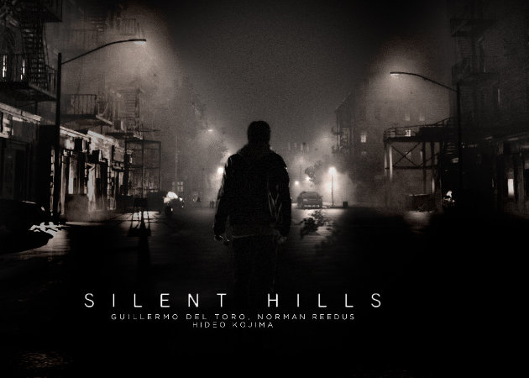
Next: A Collection Without . . .

Slide 8
“We just don’t want to be pursuing libraries. We appreciate libraries and we value them, but we expect that they follow the terms of agreement.”

Slide 9
New Problems: No Arms-Length Negotiation
Licensing
Consumer-Licensed
Contracts preempt statutory exceptions
No physical artifact
All that +
Unacceptable Boilerplate
Unanticipated Uses
Digital Rights Management

Slide 10
Infrastructure of Exceptions
Preservation
& Access
Use in
Instruction
Personal
Use
Circulation
“Personal Use”
“Lawfully Made”
“Teaching, Scholarship, Research, Transformation”
“Commercial Advantage”

Slide 11
1201: Adjacent Exceptions
Preserving abandoned video games
Ripping Blu Ray/DVD for remixes
Jailbreaking phones, tablets, etc.

Slide 12
“Help Us, Maria Pallante, You’re Our Only Hope!”

Slide 13
A Vicious Circle

Slide 14
New Law: ReDigi and Kirtsaeng
Notes:
Tie to 2001 report

Slide 15
Best Practices

Slide 16
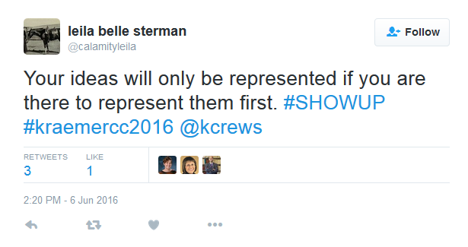

Slide 17
William Cross
NCSU Libraries
@tceles_B_hsup

