Slide 1
Managing an Open Access Fund Tips from the Trenches
Heidi Zuniga and Lilian Hoffecker
Health Sciences Library, University of Colorado
Notes:
My Co-author Heidi Zuniga, and I will be presenting together. After the first half, Heidi will take over.

Slide 2
What is an OA Fund?
“Open-access (OA) literature is digital, online, free of charge, and free of most copyright and licensing restrictions.” – Peter Suber
Many OA journals follow the ”author-pays” business model – Gold open access – where authors pay a fee while providing free access to readers
An OA fund provides financing for the article processing charge (APC) ranging from a few hundred dollars to $4000
Libraries have been the primary institution managing OA funds
One of the drivers of the OA movement is the transfer of copyright by authors to publishers at the time of publication
Notes:
I imagine many of our audience members are familiar with the open access movment and specifically OA funds, but just a quick review or quick introduction to what this is all about…
Peter Suber (Harvard Office of Scholarly Communication)- “Open-access (OA) literature is digital, online, free of charge, and free of most copyright and licensing restrictions.”
The best known business model for subsidizing OA is the “author-pays” model, where authors pay a fee to publish rather than readers or subscribers paying a fee to access the articles. Gold Open Acces model.
The APC can be a few hundred dollars to as much as $4000.
An OA fund, often administered by libraries, helps pay for the author fee or the article processing charge.
Finally, one of the drivers for the OA movement has been the interest in retaining copyright to the article to be published instead of automatically transferring ownership to the publishers.

Slide 3
Questions to Ponder
Should libraries have an OA Fund? Are we paying twice – as a subscriber to a journal and as a funder of the APC (article processing charge) sometimes for the same journal?
Should librarians encourage Green OA instead of Gold OA so that authors can retain copyright?
Instead of paying the publishers can libraries financially contribute in another way that prioritizes the authors and the readers over the publishers?
Notes:
We did want to have you think about a few questions but in the interest of time, I will not go over them. Please look them over and maybe over break or lunch we will have an opportunity to discuss them.
Before I get started on the main theme of this presentation, we wanted to offer a few questions for you to ponder during the presentation, and discusss later at the end of this session, at a break or even with your colleagues at your own institutions.
And as you can see, these questions are interrelated:
Is the author-pays model a viable business model?
Should libraries even have an OA Fund? Are we paying twice – as a subscriber to a journal and as a funder of the APC (article processing charge) sometimes for the same journal?
Should librarians encourage Green OA (making articles available before formal publication in an institutional repository) instead of Gold OA so that authors can retain copyright?
Instead of paying the publishers can libraries financially contribute in another way that prioritizes the authors and the readers over the publishers?

Slide 4
Beginning of the HSL OA Fund
Started Spring 2013
Cancelled PLoS and BMC memberships to apply these fees to the OA Fund
Growing familiarity with OA and interest in publishing in these journals, but no funding
Notes:
And now, the OA Fund…
Started Spring 2013
Motivated to start OA fund when library's membership discount to PLoS and BMC were not being used very much and furthermore the discounts were limited , 15% or so. It seemed more effective to use the membership budget to offer awards to publish in any OA journal.
Funding for OA fee didn’t seem to be available through grants or from campus units

Slide 5
Requirements
Must be an affiliate of our campus
Must be a fully OA journal
Must be the first or corresponding author
Articles must have been submitted or accepted
Applicants should not have other funding source
Priorities: 1.) students; 2) residents/post-docs/jr fac; 3) other faculty
Must deposit article in our IR
OA Fund Lib-Guide
Notes:
Must be AMC affiliate
Must be legitimate fully OA journal – we vet the journals. Had to deny one because we weren’t sure if it was legitimate. We evolved from accepting hybrid journals to no longer. We had considered naming the publishers, e.g., PLOS, BMC, etc only.
Must be first or corresponding author – this has been an issue. Used to be, "made a substantive contribution”
Applicants should not have other funding source – but this is hard to verify. It’s an honor system
Articles must have been submitted or accepted; no in-prep articles
Priorities: 1.) students; 2) residents/post-docs/Jr Fac; 3) Other Faculty. Points Matrix. Studetns get priority though others can qualify if funds remain. We use a point system to quantify the applicants’ eligibility.
Libguide link http://hslibraryguides.ucdenver.edu/openaccess/fund

Slide 6
Logistics
2 rounds a year
Funding source: library budget
Check the qualifications of the applicants
If qualified, the full APC is funded
Once funding is awarded (reserve the funds), we allow 6 months for the paper to be published.
Pay the publisher directly once we receive the invoice
Notes:
2 rounds a year. We announce the round, what day and what time. Usually we need to send only one mass email and have an announcement on the library’s home page. Open the application form only when we’re ready to accept applications. Close it as soon as our budget for the round is expended.
Funding source: library budget. We would like to have other campus units contribute
Check the qualifications of the applicants = must meet the requirements stated in previous slide, and submit application in time.
We pay for the full APC and work with the publisher for payment. We used to pay up to $1000 but the partial payment turned out to be a difficult accounting issue. May not be a problem at your institution.
Budget is allotted with each round
Allow 6 months for the paper to be published. Extensions
Pay the publisher directly rather than the individual applicant. Related to our finance office’s rules.

Slide 7
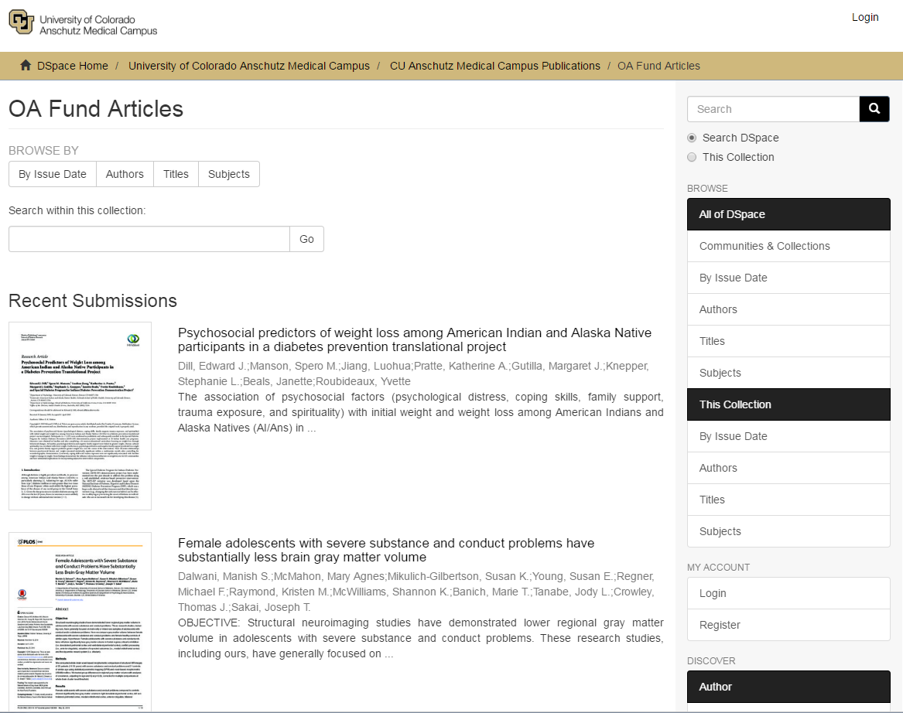
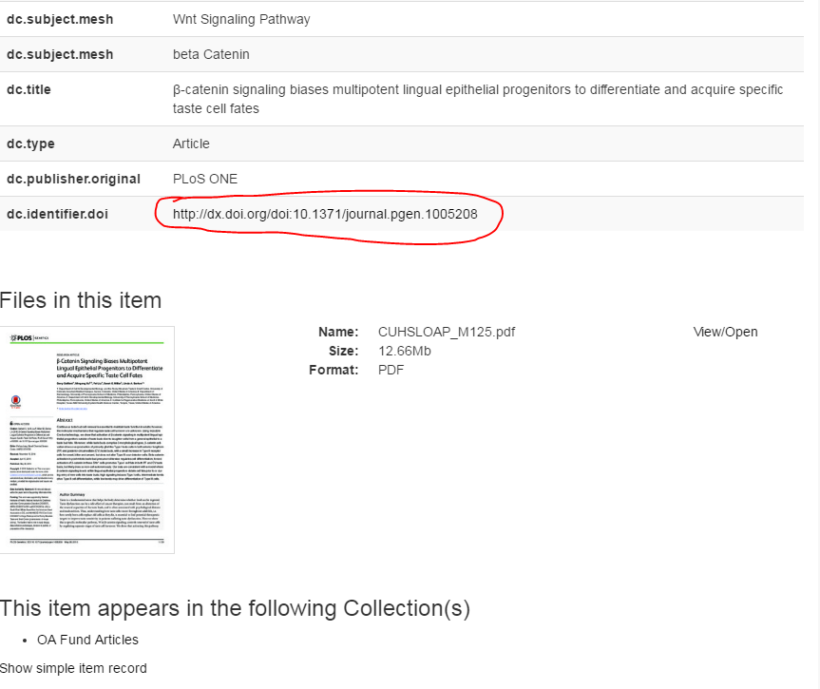
Institutional Repository
Notes:
We ingest a PDF but we also link to the publisher’s site in the full item record

Slide 8
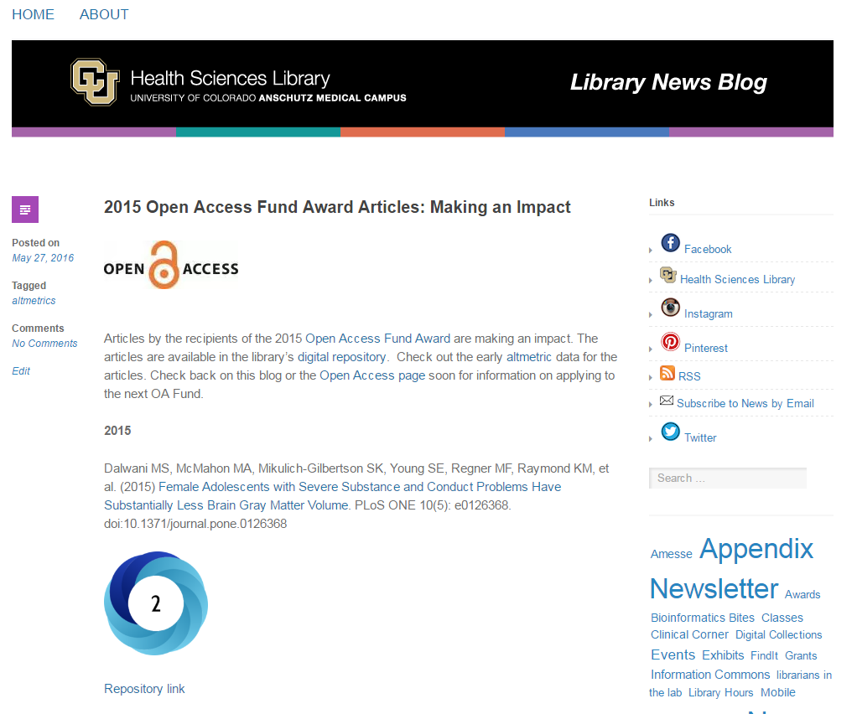
Tracking the Visibility of the Funded Articles
Notes:
https://hslnews.wordpress.com/2016/05/27/2015-open-access-fund-award-articles-making-an-impact-2/
We link to both the publisher’s site, Altmetric’s site, and the repository in the blog posts

Slide 9
Statistics
Allocated budget over the last 3 years: $50,000
Expended: $37,576
Total number of applicants: 55
Total number funded: 39
Notes:
How much have we spent: $50,000 allocated; actual amount expended: 37,576.
Difference is due to:
- awardees declining the award because they couldn’t afford the remaining balance of the APC when we were only making particla payments
- misunderstanding of our rules (e.g., repeat applicants; non-OA journal; hybrid journal, etc.)
- manuscript rejection (but only once)
- problematic journal (only once)
How many applicants: 55
How many have we funded: 39

Slide 10
Awardees by School
Notes:
Overwhelmingly SOM. Why? Might be there’s a more significant culture of research in medicine compared to other disciplines.

Slide 11
Awardees by Status
Notes:
We funded a fair number of faculty and residents even though preference was given to students.

Slide 12
Awardees by Publisher

Slide 13
Lessons Learned and Challenges Experienced
Payments
Giving preference to new scholars
Limit the publishers
Source of funds- do researchers have money from grants, do medical students have grant money
Notes:
These notes and the slide itself are very rough. Just trying to jot things down…
Payments:
Include an accounting staff member on your team - tell a story with this
Make timely payments – publishers won’t publish article until they are paid
Paying an international publisher
Partial payments vs paying full amount
Giving preference to new scholars:
First/contributing author: senior authors ”using” students for funding?
Commercial publishers??
Source of funds:
Misperception: “Why aren’t the students or faculty getting money through their grants?” Vice Chancellor of Research was not interested (not informed about OA)
Others:
Make the rules clear in writing (link to libguide http://hslibraryguides.ucdenver.edu/openaccess/fund)
Long timeline – 6 months +

Slide 14
Thank you
Contact Us:
heidi.zuniga@ucdenver.edu
lilian.hoffecker@ucdenver.edu

