Slide 1
Legal Issues When Instructors Require Online Distribution of Student Work
Kraemer Copyright Conference
June 7, 2016
Break-out Session I
Micah Zeller, JD
Copyright & Digital Access
WUSTL

Slide 2
Notes:
No single approach to handling the dissemination of student work.
And no single reason why instructor may want to require it.
motivations vary
<create examples for other students to model> | <show the type of work product created under her teaching> | <as record for accreditation or recruitment purposes>

Slide 3
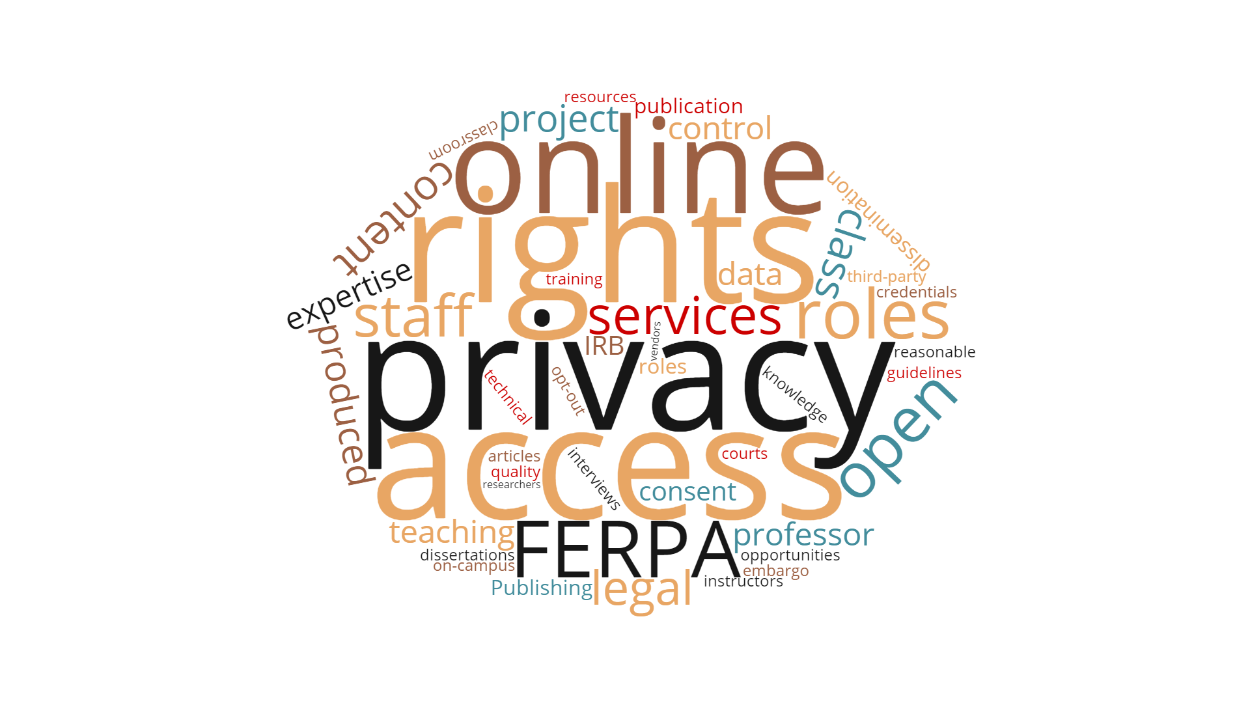
Notes:
Faculty
Student
Librarian
<rights> <roles> <responsibilities>
What can you do?
When are you able to do it?
Who is responsible for what?
LEGAL MECHANISMS
PRIVACY RIGHTS
ONLINE IDENTITY
PLATFORM CHOICE
ETHICAL Qs re: MANDATING DIGITAL PRESENCE

Slide 4
Why us?
Notes:
= experience + perspective
building online collections
establishing access options
supporting pedagogical outcomes
platforms + functional specialists
scholarly communications :: author rights | data mgmt. | metadata + preservation
What KLS calls “consulting knowledge managers”
cultivating expertise in range of fields promotes ability to continue providing meaningful support
AND can be difficult to see how issues converge unless you’ve dealt with them before and know what to look for.
Hands Holding Jigsaw, PublicDomainPictures.net, http://www.publicdomainpictures.net/pictures/20000/velka/hands-holding-jigsaw.jpg.

Slide 5
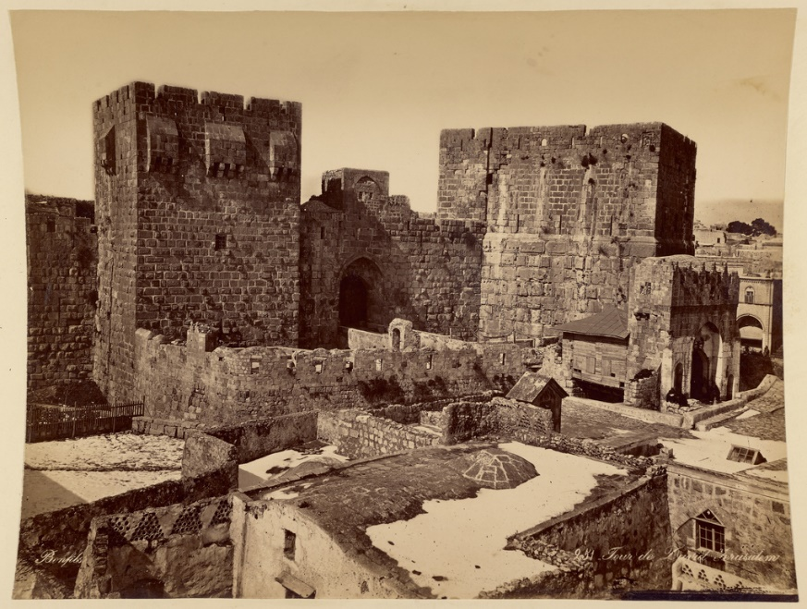
Scenario I
• Intro to Archeology class
• students co-create videos
• condition of course credit
• instructor uploads
• private channel
• not in syllabus
• ?
Intro to Archeology class
Notes:
<Digital image courtesy of the Getty's Open Content Program.> http://www.getty.edu/museum/media/images/web/enlarge/06259901.jpg

Slide 6
Legal Mechanisms
express permission
implied license
platform TOS
Notes:
How does instructor know whether she has legal justification to make student work available online?

Slide 7
Implied Licenses
• Existence
• Scope
• Nature
• Duration
• “Fairness”
Totality of conduct
Practical function + consequences

Slide 8
Platform TOS
Notes:
§6(c)
For clarity, you retain all of your ownership rights in your Content. However, by submitting Content to YouTube, you hereby grant YouTube a worldwide, non-exclusive, royalty-free, sublicenseable and transferable license to use, reproduce, distribute, prepare derivative works of, display, and perform the Content in connection with the Service and YouTube's (and its successors' and affiliates') business, including without limitation for promoting and redistributing part or all of the Service (and derivative works thereof) in any media formats and through any media channels. You also hereby grant each user of the Service a non-exclusive license to access your Content through the Service, and to use, reproduce, distribute, display and perform such Content as permitted through the functionality of the Service and under these Terms of Service. The above licenses granted by you in video Content you submit to the Service terminate within a commercially reasonable time after you remove or delete your videos from the Service. You understand and agree, however, that YouTube may retain, but not display, distribute, or perform, server copies of your videos that have been removed or deleted. The above licenses granted by you in user comments you submit are perpetual and irrevocable.
§6(d)
You further agree that Content you submit to the Service will not contain third party copyrighted material, or material that is subject to other third party proprietary rights, unless you have permission from the rightful owner of the material or you are otherwise legally entitled to post the material and to grant YouTube all of the license rights granted herein.
<The Verge, http://www.theverge.com/2013/5/15/4334956/microsoft-responds-to-youtube-windows-phone-takedown-notice>

Slide 9
Privacy Interests
FERPA
↑ focus from state leg
technology-mediated learning > higher-ed
Notes:
46 states introduced 182 bills addressing student data privacy in 2015 (via Data Quality Campaign)
Student Digital Privacy and Parental Act of 2015 (introduced 2015) – would significantly amend FERPA if enacted

Slide 10
FERPA
• Education records
• Disclosure
• Waiver
• Remedies
• “Implied pedagogical exception”
Past works
What’s the library’s role?
What are we protecting?

Slide 11
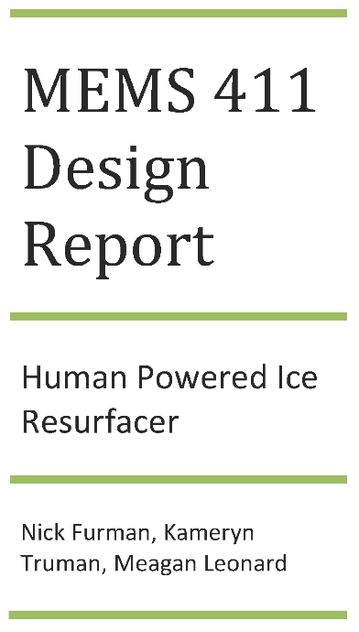
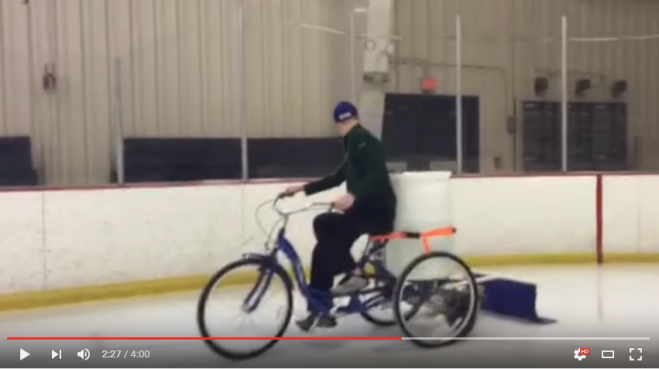
Scenario II
• Mechanical Engineering capstone course
• student-team projects
• create conceptual design study
• produce working prototype
• make report publicly available
Mechanical Engineering capstone course
Notes:
<Furman, Nicholas; Truman, Kameryn; and Leonard, Meagan, "Human Powered Ice Resurfacing Machine" (2015). Mechanical Engineering Design Project Class. Paper 24. http://openscholarship.wustl.edu/mems411/24>

Slide 12
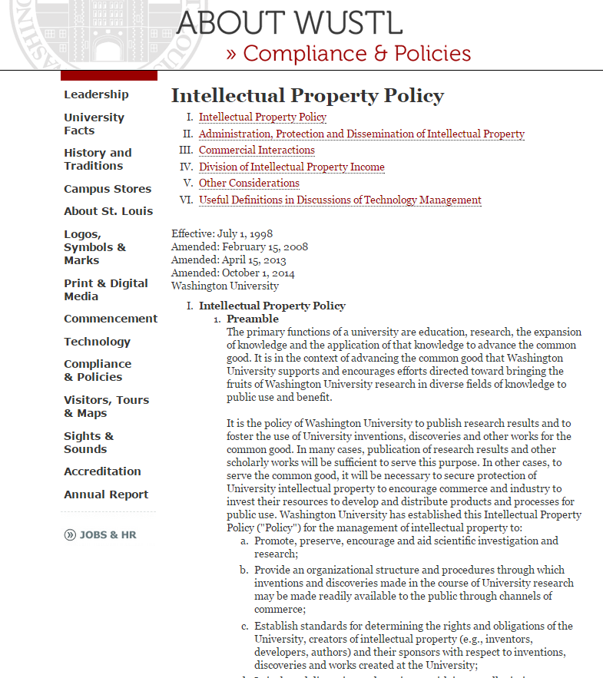
Why?
Notes:
“fair and consistent mechanism through which IP may be made available for public use”

Slide 13
One purpose: allocate rights
Creator (author/inventor) owns what she makes
Work Made For Hire: employer deemed to own
IP Policy: re-assigns ownership of scholarly works back to creator
Notes:
**One central purpose of the IP Pol’y is to allocate ownership of things created by WU employees**

Slide 14
Context: “shifting landscape”
• “Increase efforts & energies in innovation + entrepreneurship”
• “Expand beyond traditional academic output of publication”
• “Create robust innovation ecosystem; engage students, faculty, and alumni in research innovation and commercialization”
• “Enhance WUSTL research training cultures, enable new educational paradigms, maximize outcomes in non-academic careers”

Slide 15
Student IP
• Authorship ↔ ownership
• Research projects/data
• Collaboration wt faculty & grad students
• Practicums, extracurricular competitions
• Responsibilities, disclosure reqs
Notes:
∑ key for students to understand rights + responsibilities w/r to owning, sharing, distributing research and their work.

Slide 16
Platform Choice
• Login separate from university credentials
• 3rd-party registration
• Downstream control
• Reading trails

Slide 17
Scenario III
• AMCS sophomore seminar
• clear IRB exemption / oversight
• conduct interviews wt local residents
• add oral history to digital repository
• add oral history to University Archives
American Cultural Studies seminar
Notes:
<Blair Buttke, Microphone Series, CC BY NC-ND, https://www.behance.net/gallery/Microphone-Series/3804777>
<http://digital.wustl.edu/ferguson/>

Slide 18
Online Identity
• Artifacts of a specific time
• Pedagogical impact
• Nature of assignment
• Visibility, experimentation

Slide 19
Upshot
• Risk management >> letter of the law
• Meaningful opportunity to opt-out
• “Multiplicity of labels obscures commonality of the issues”
• Opportunity to build on existing services

