Slide 1
Interactive Copyright Education for 3D Objects
Camille Thomas
Scholarly Communication Librarian
Texas Tech University
Kraemer Copyright Conference 2017

Slide 2
SHAPES Background
Sharing and Helping Academics Prepare for Educational Success (SHAPES) (CC-BY-NC: Ryan Litsey)
Traditional collaborative networks for new items!
Notes:
-Not trying to meet technology needs in a vacuum
University of Houston partners

Slide 3
SHAPES: Workflow
Workflow
Metadata schemas
Print Time: 12-52 hours
free then fee
SHAPES vs. Markerspace
Notes:
-Print time depends on depending on the size, complexity
-Fee for all faculty after completion of grant
- Different printers from Polybots in public space

Slide 4
SHAPES Background: In Action
Visualize abstract concepts
Multiple learning styles
Accessibility
Image: Chavez, A. (2016). Professor Taking Higher Education to a New Dimension. TTU College of Education News.
Notes:
-Easier to visualize abstract concepts
-Appeals to multiple learning styles
-Learning tool for differently abled students

Slide 5
SHAPES: ILL and Copyright
Interlibrary Loan + Copyright
First purchase
Exemptions
90 day file holdings
Student designers are work for hire students
Authorship and attribution
Notes:
As with traditional ILL, the borrowing institution would hold the specific copy of the file for 90 days and then delete
The master file/ rendering stays in the central database
Patron only interacts with the printed object

Slide 6
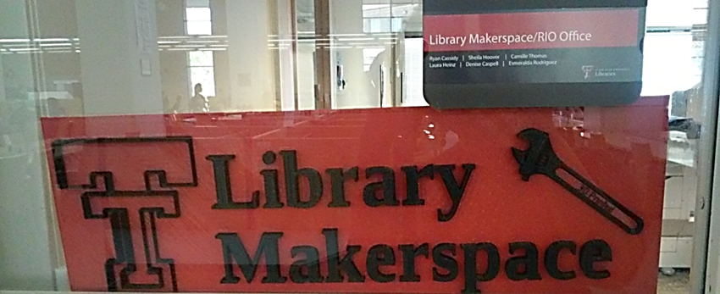
Library Makerspaces and Copyright
Liability
Public Space
Notes:
Section 108 unsupervised copier exception

Slide 7
3D and Copyright
Files vs. Objects
Museums, Non-academic
Solutions instead of reactions

Slide 8
How do we make that into an interface??

Slide 9
Copyright Education
Lecture
Gamification
Face-to-face
MOOCs

Slide 10
Instructional Considerations
Digital Pedagogy
Understanding By Design
Active/ Interactive Learning
Remixing Workshops
Images: NC State Libraries
CC-BY-SA

Slide 11
Planning
Users and Creators
Copyright basics
5 Rs of Open
Files > Objects
Creative Commons Licenses
Terms of Agreement

Slide 12
Tools
Guide on the Side
Twine
Notes:
-Minimal computing and open source tools for scalability and adaptation
-LibSurverys in LibApps 2.0 is proprietary software with similar function to GOTS
-Articulate 360 and Storyline2

Slide 13
Intersections, Outcomes, Predictions

Slide 14
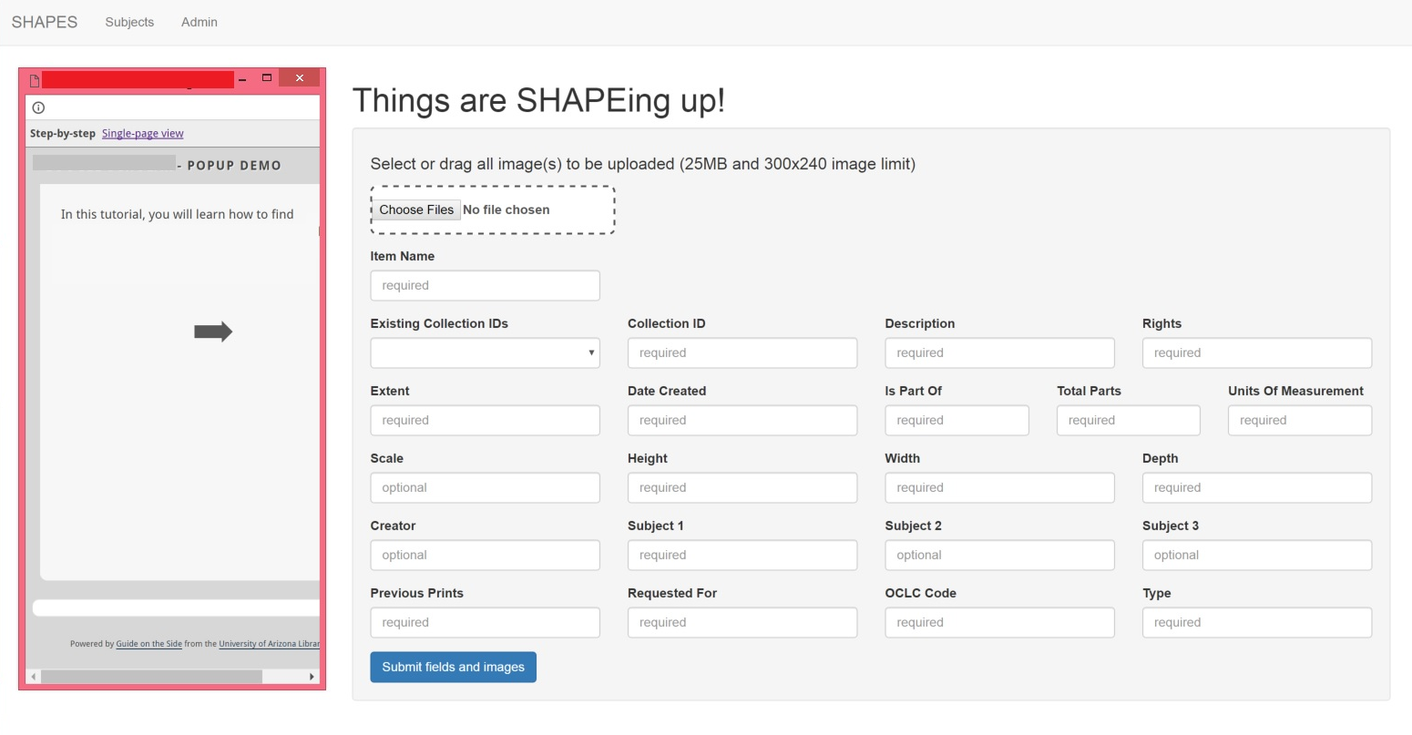

Slide 15
The Future and Other Considerations
Reporting infringement claims
Flagging items
Users learning copyright information upon download
Digital Card Sorting
“Instructional drop box”

Slide 16
Opportunity for Libraries
Source Verification
Trust
Collaborate with wider Maker communities
Tools and Best Practices

Slide 18
Camille Thomas
camille.thomas@ttu.edu
@afrofuturistlib

